Slide 1
CASESTUDY: AIRPORTS ANALYTICS Analysis with PIG
19CSE357 | Group 11
BIGDATA ANALYTICS

Slide 2
RAVELLA ABHINAV
CB.EN.U4CSE19453

Slide 3
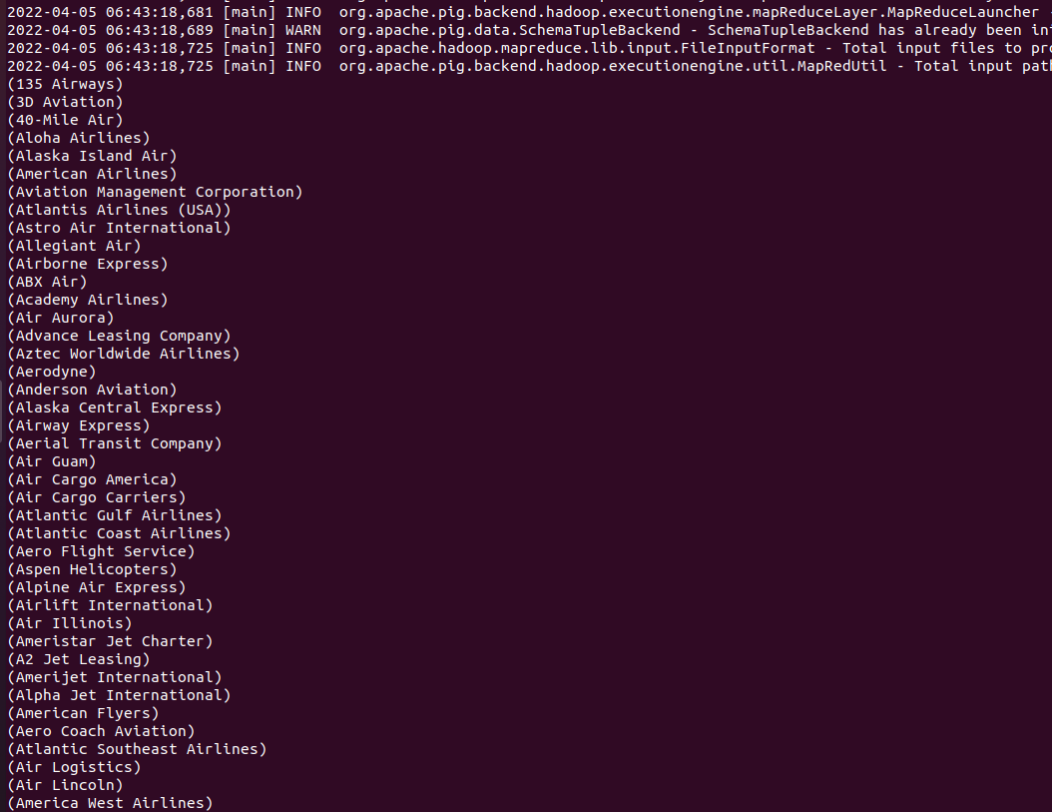
1. Find the names of active airlines in territory ‘Unites States’?
Query:
active_airlines = filter finalair by active == 'Y';
active_airlines_usa = filter active_airlines by territory == 'United States';
find_active_airline_names_in_usa = foreach active_airlines_usa generate airline_name;
dump find_active_airline_names_in_usa;

Slide 4
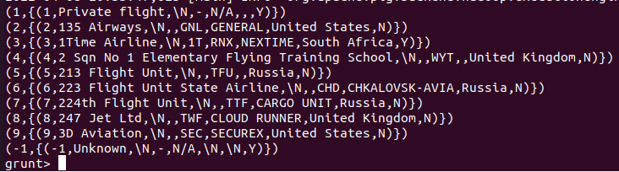
2. Group airline id by active status;
Query:
ae = group finalair by airlineID;
ans = limit ae 10;
illustrate as;
dump as;

Slide 5
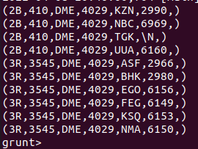
3. Split relation based on src airport id i.e, equal to DME to get exclusive info.
Query:
split routes into ru_dme if route_source_iata == 'DME' , ru_not_dme if route_source_iata != 'DME';
dump ru_dme;
dump ru_not_dme;

Slide 6
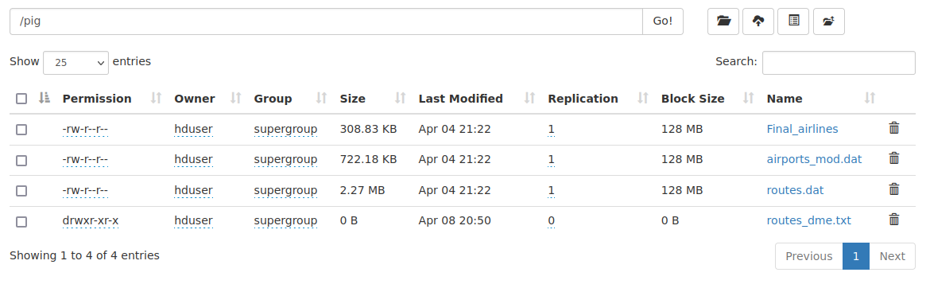
4. Store ru_dme relation into text file separated by delimiter “,”.
Query:
store ru_dme into '/pig/routes_dme.txt' using PigStorage(',’);
Output:

Slide 7
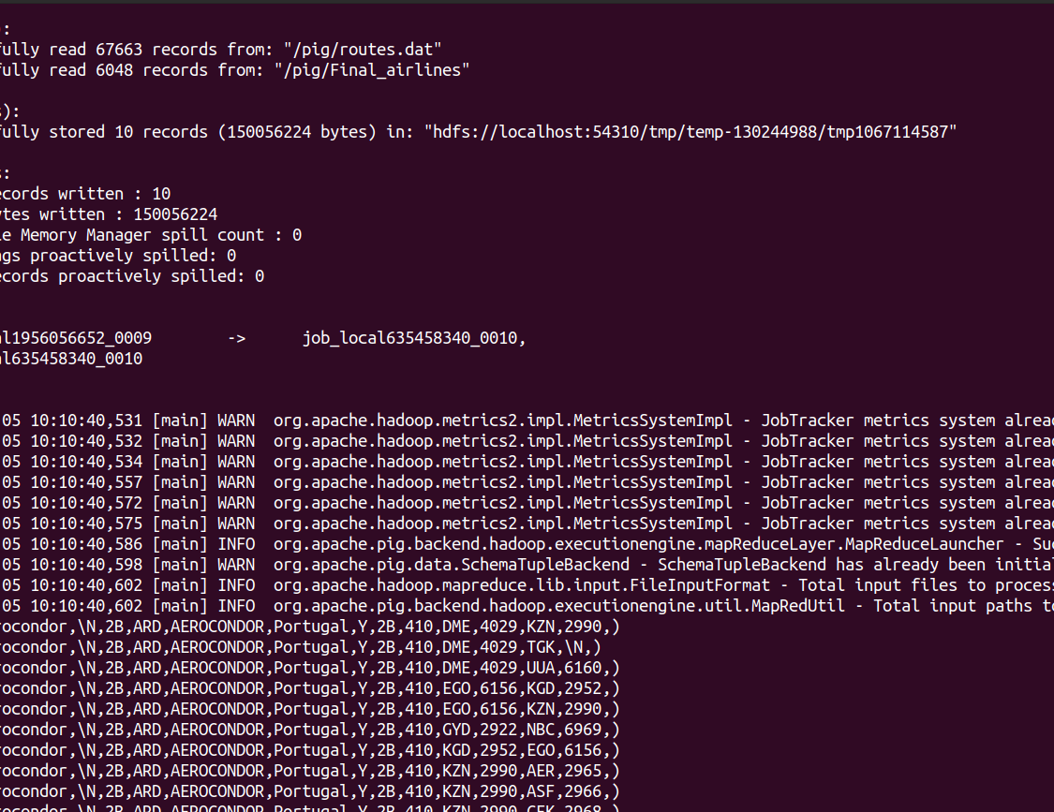
5. JOIN Command:
Query:
right_join = JOIN finalair BY airline_iata RIGHT OUTER, routes BY route_iata;
LIM = LIMIT right_join 10;
dump LIM;
Output:

Slide 8
S SHANTHAN REDDY
CB.EN.U4CSE19459

Slide 9
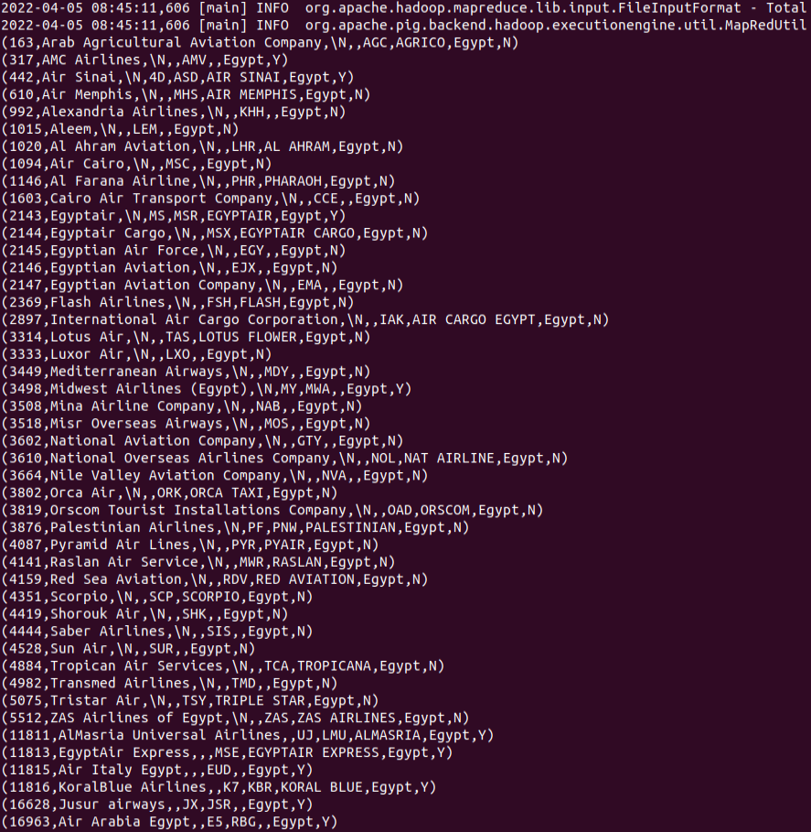
egyt = filter finalair by territory == 'Egypt'; dump egyt;

Slide 10
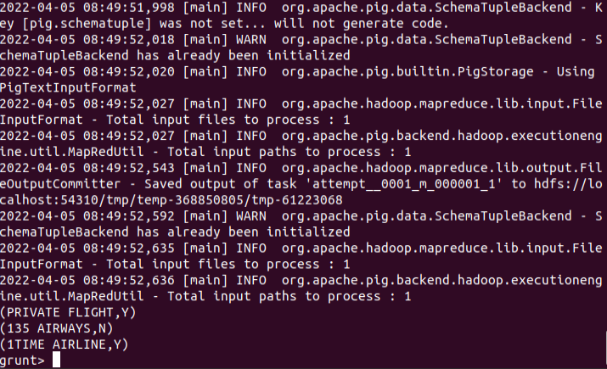
2. up = foreach finalair generate UPPER(airline_name),active; a = limit up 3; dump a;

Slide 11
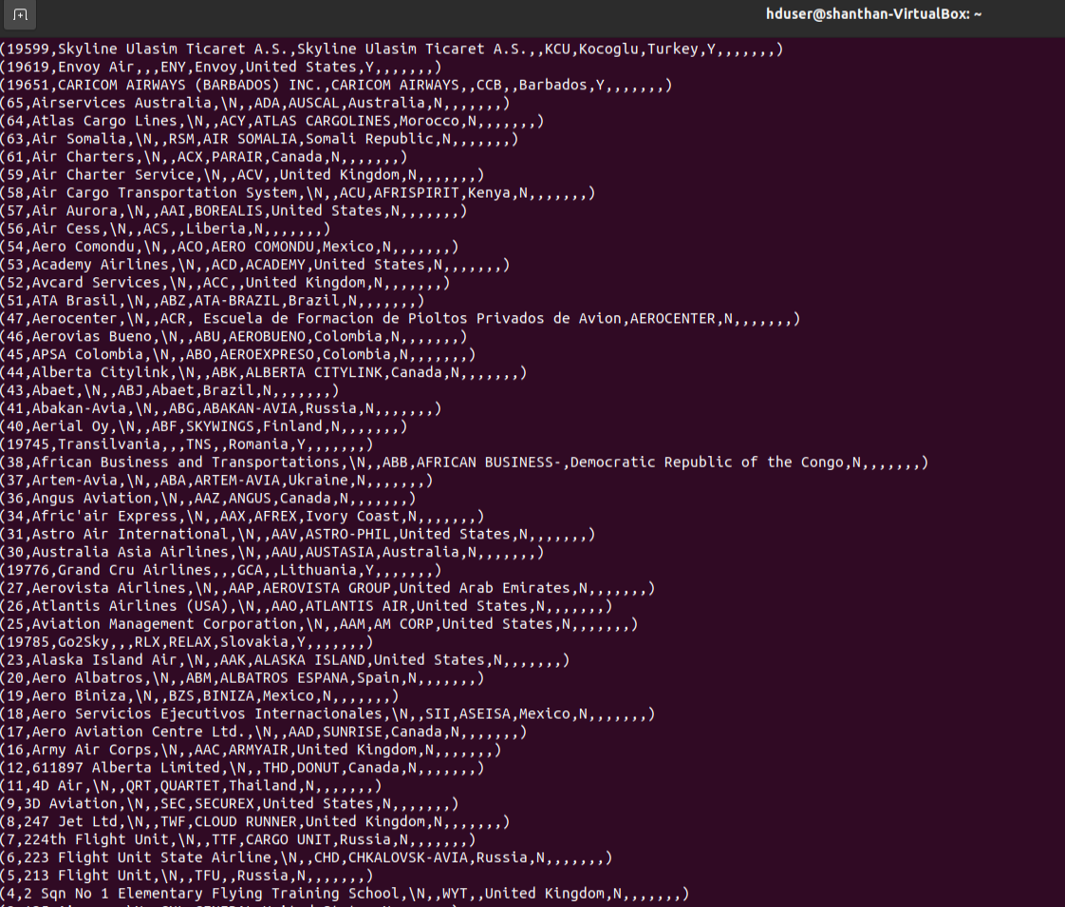
3. outer_left = JOIN finalair BY airline_iata LEFT OUTER, routes BY route_iata; dump outer_left;

Slide 12
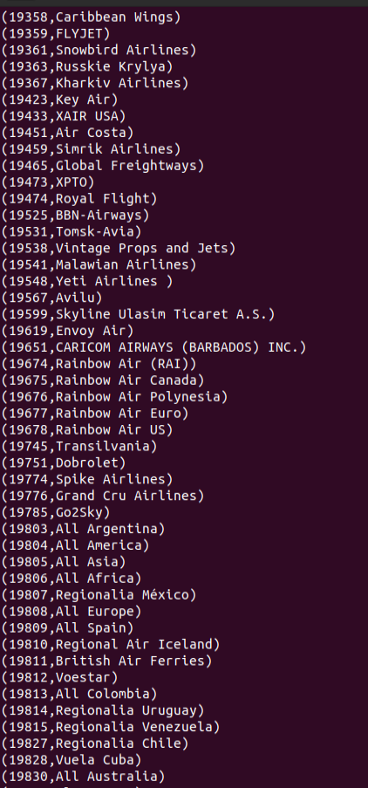
4. order_data = ORDER finalair by airlineID DESC; Disp=FOREACH finalair GENERATE airlineID,airline_name; Dump disp;

Slide 13
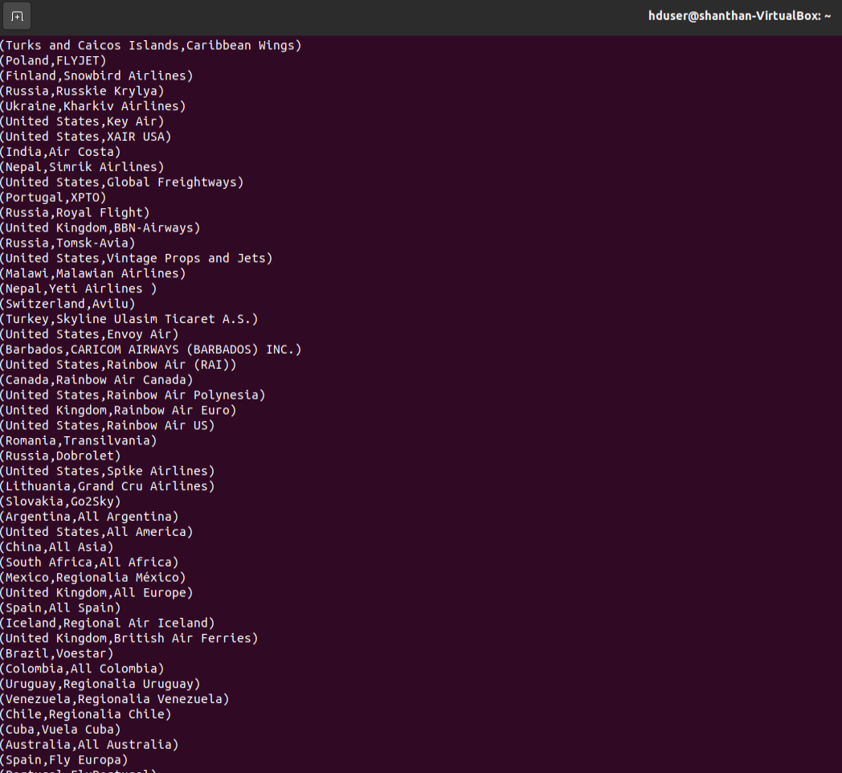
5. group_data = GROUP finalair by territory; display = FOREACH finalair GENERATE territory,airline_name; Dump display;
CB.EN.U4CSE19459

Slide 14
P Sai Koushik
CB.EN.U4CSE19449

Slide 15
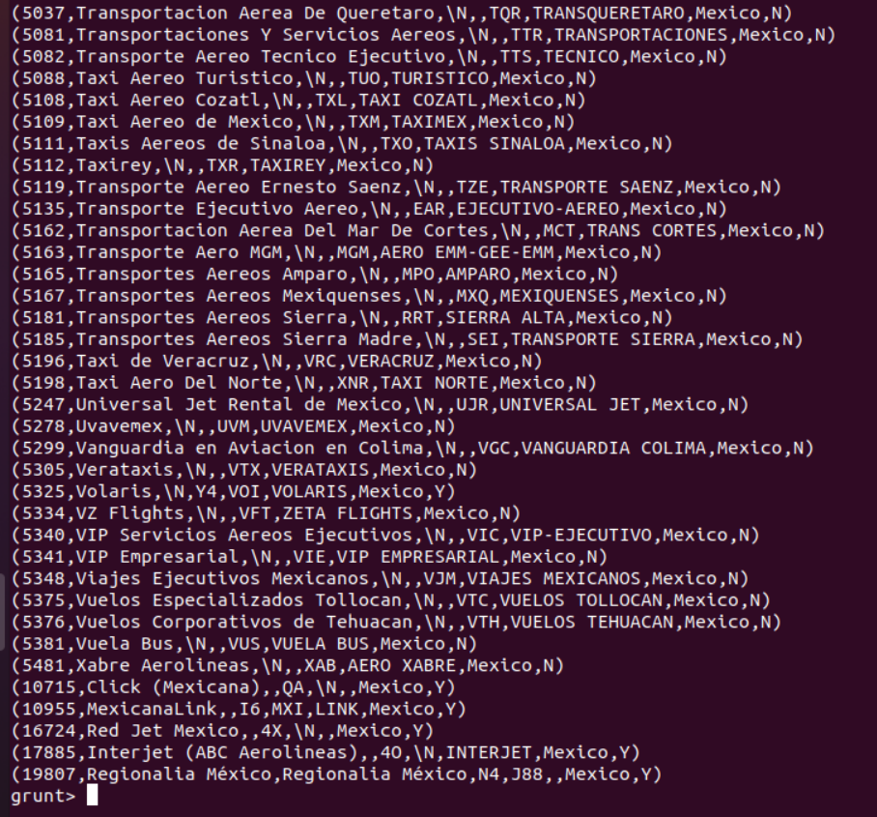
1. SPLIT finalair into finalair1 if territory=='Mexico', finalair2 if territory=='Canada’;
dump finalair1;

Slide 16
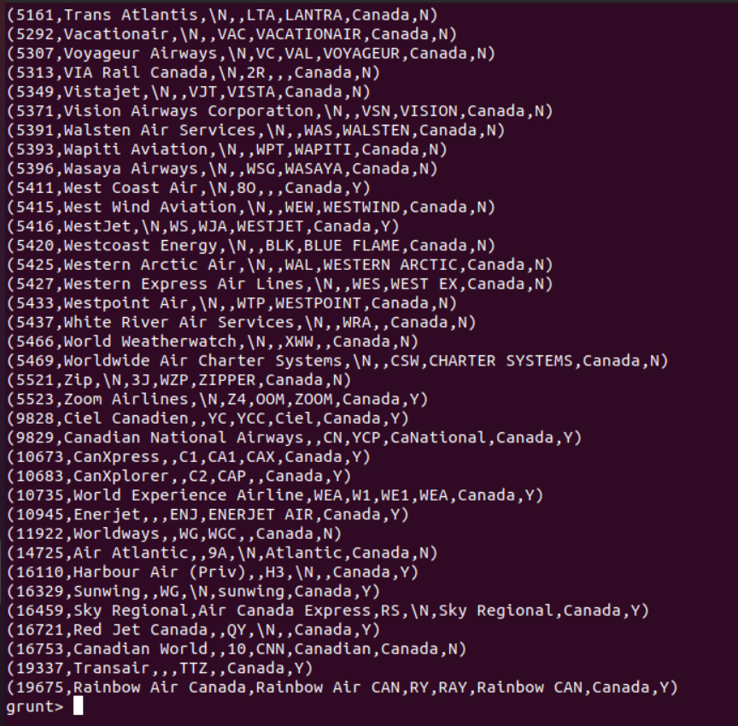
Dump finalair2;

Slide 17
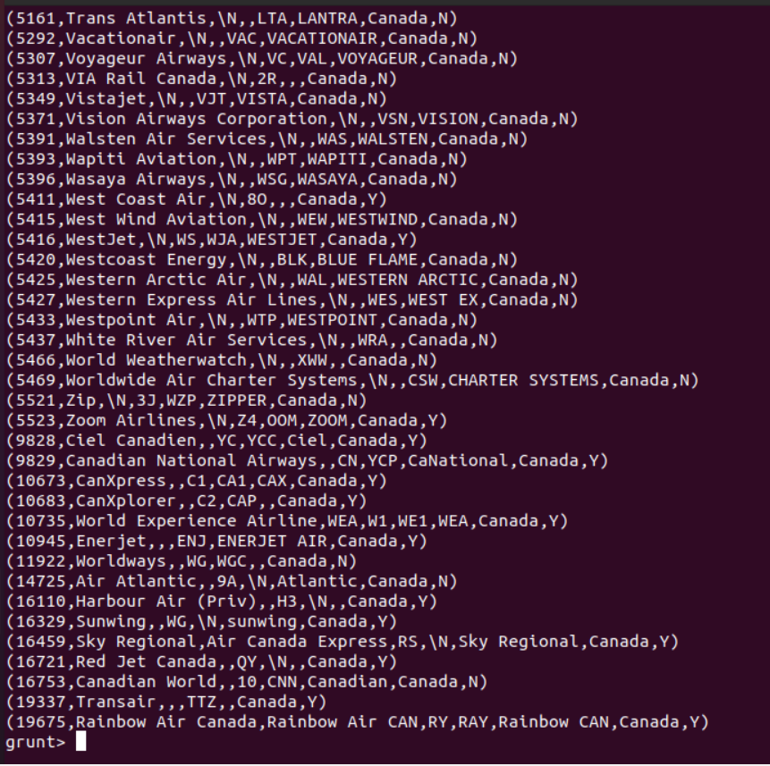
2. finalair3 = UNION finalair1, finalair2;
dump finalair3;

Slide 18
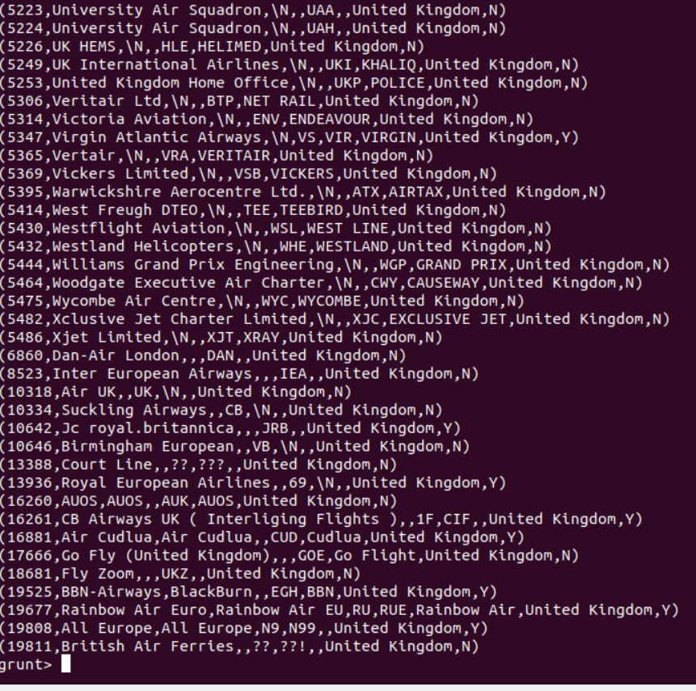
3. A = filter finalair by territory == 'United Kingdom’;
dump A;

Slide 19
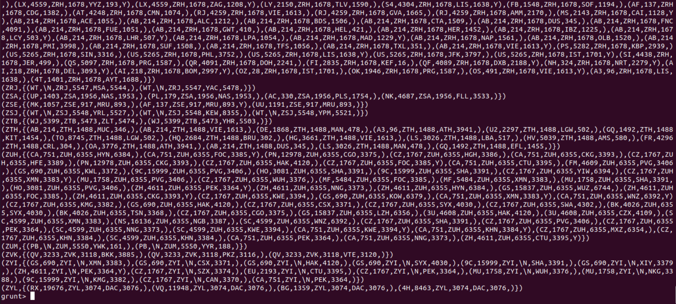
4. group_data = GROUP routes by route_source_iata;
dump group_data;

Slide 20
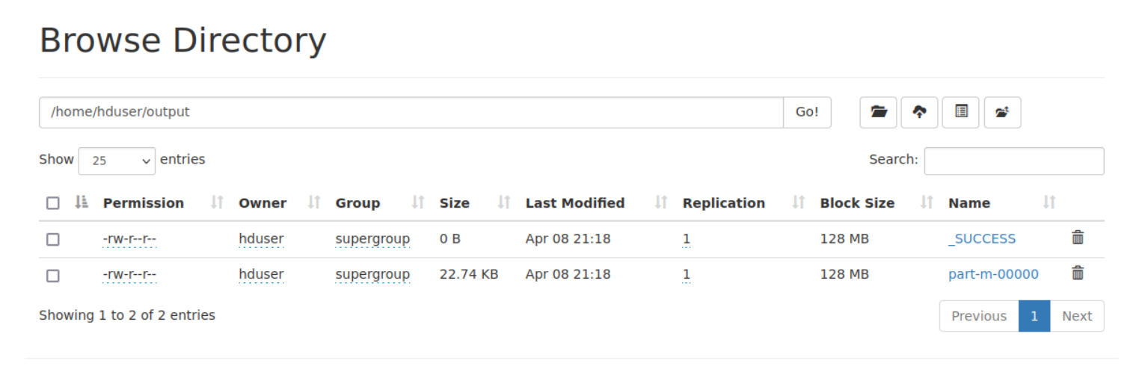
5. store A into '/home/hduser/output' using PigStorage (',’);
hadoop fs -cat /home/hduser/output/part-m-00000

Slide 21
Divesh kosuri
CB.EN.U4CSE19422

Slide 22
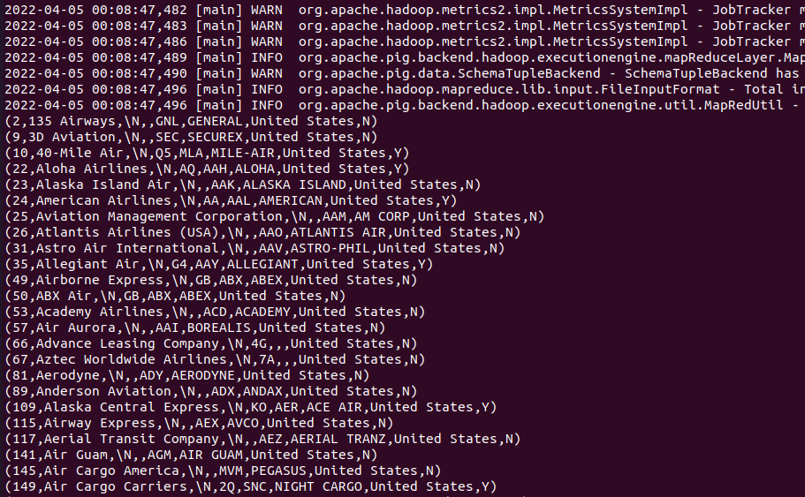
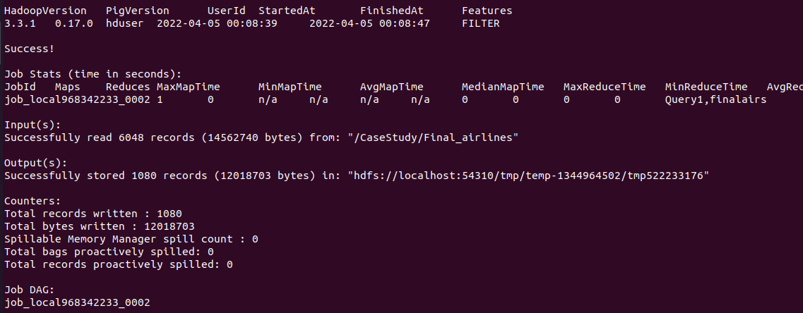
Query 1: Query1 = FILTER finalairs BY territory == 'United States'; Dump Query1;

Slide 23
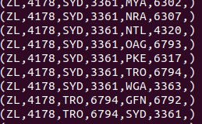
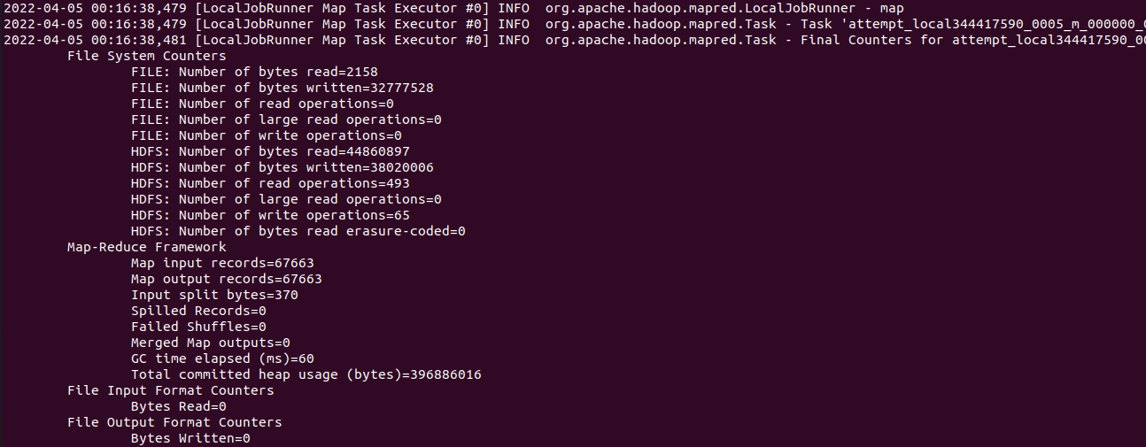
Query2 : DISTINCT Query2 = DISTINCT routes; DUMP Query2;

Slide 24
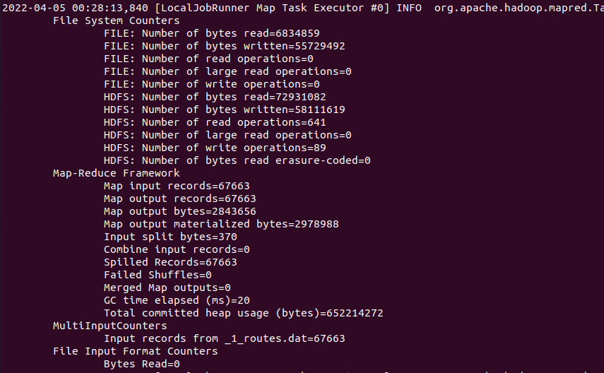
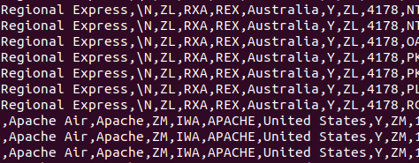
Query 3: JOINS Query3 = JOIN finalairs BY airline_iata, routes BY route_iata; DUMP Query3;

Slide 25
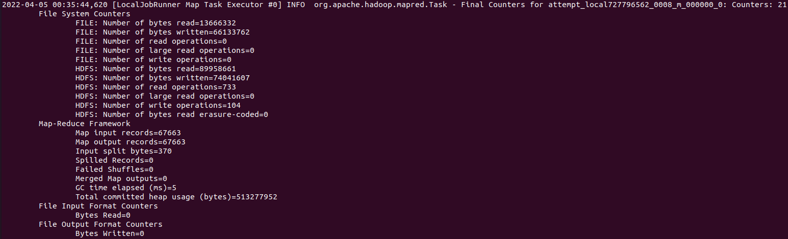
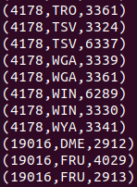
Query 4: FOREACH and GENERATE Query4 = FOREACH routes GENERATE route_airid, route_source_iata, route_stops; DUMP Query4;

Slide 26
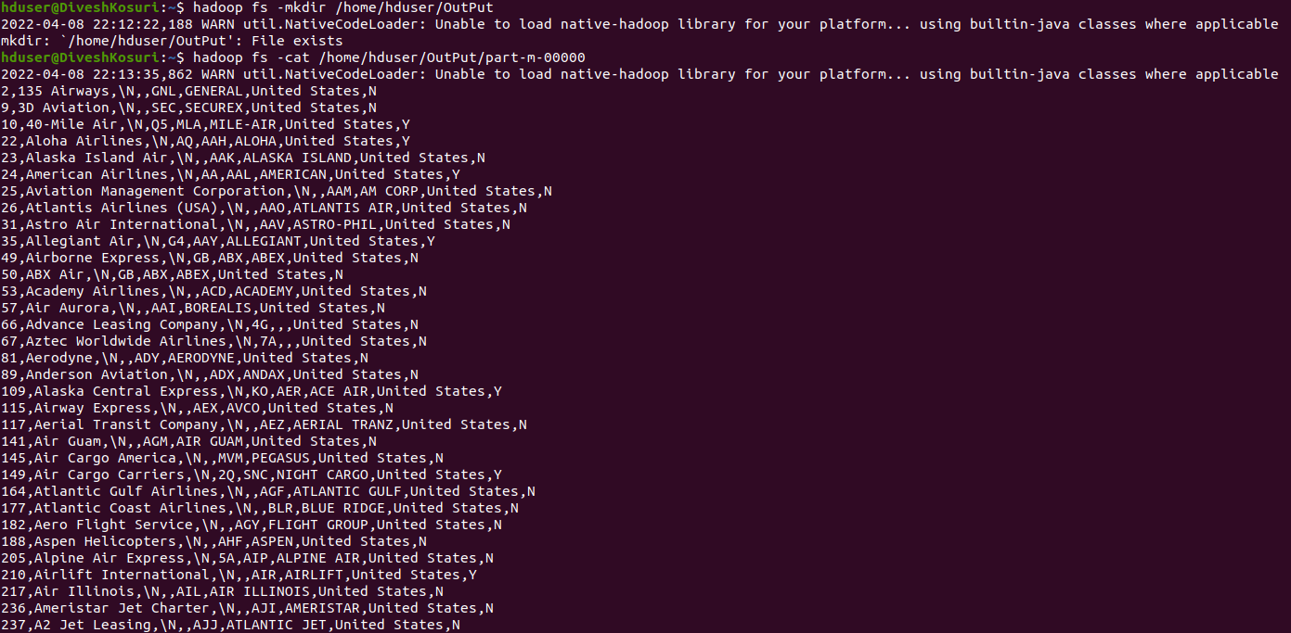
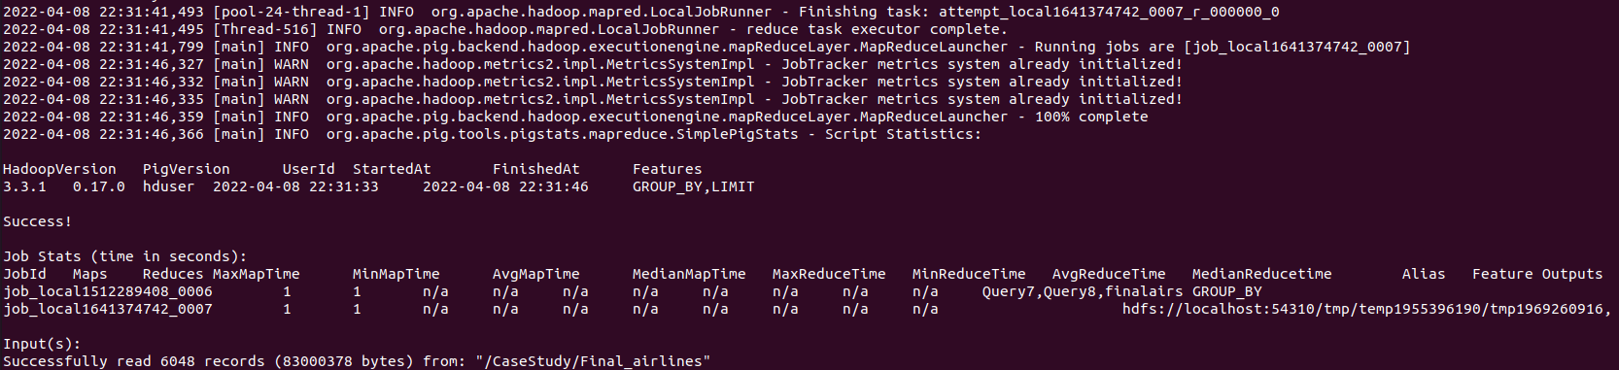
Query 6: STORE hadoop fs -mkdir /home/hduser/OutPut STORE Query1 INTO '/home/hduser/OutPut' USING PigStorage (',’); hadoop fs -ls /home/hduser/OutPut hadoop fs -cat /home/hduser/OutPut/part-m-00000

Slide 27
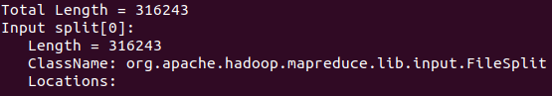
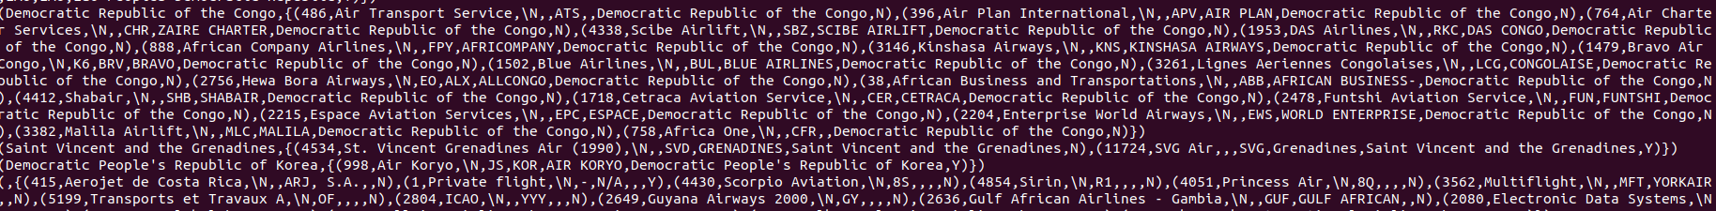
Query 7: Group Query7 = GROUP finalairs by territory; DUMP Query7;

Slide 28
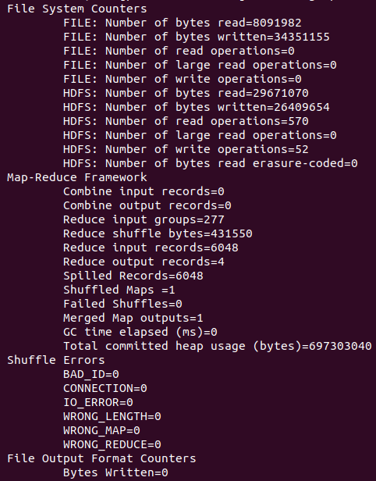
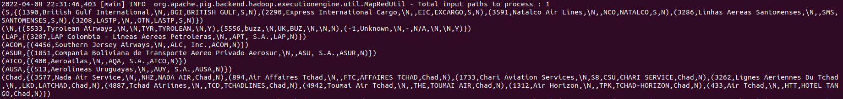
Query 8: Limit Query8 = LIMIT Query7 15;

Slide 29
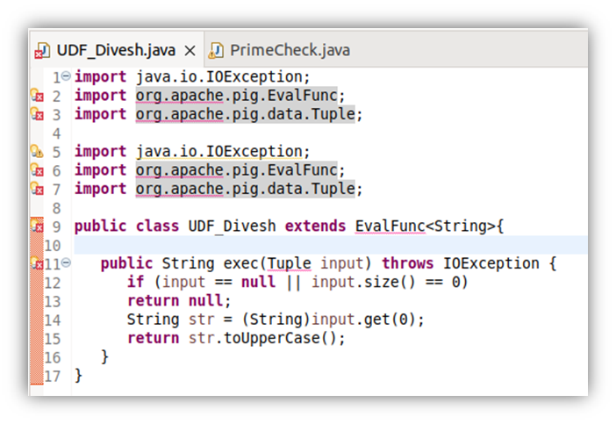
QUERY 9: UDF REGISTER '/home/hduser/BigData/JARs/UDF_Divesh.jar'; PIG_Input = LOAD '/CaseStudy/PigInput.txt' using PigStorage() AS (line:chararray); PIG_UDF = FOREACH PIG_Input GENERATE UDF_Divesh(line);

